Slide 1
MAR 580: Models for Marine Ecosystem Based Management
Lecture 8
Whole of System Modeling
Ecosystem MSE, Atlantis
Acknowledgements: Beth Fulton, Erik Olsen, Bec Gorton, Isaac Kaplan, Sarah Gaichas
15 April 2016

Slide 2
Simplified Schedule
Week | Topic | Assignments
1/29 | Intro to EBM, review of fisheries assessment models
2/5 | No Class - weather
2/12 | Stock assessment models with ecosystem processes
2/19 | Guest lecture: Food web models I (Ecopath) | HWK 1 due
2/26 | Guest lecture: Food web models II (Ecosim) | Project outlines
3/ 4 | Multispecies models, estimating species interactions
3/11 | Marine spatial planning models, marine reserve design | HWK 2 due
3/18 | SPRING BREAK
3/25 | No Class - IMS Research Symposium (several mini-lectures) | HWK 3 due
4/1 | Valuation of ecosystem services
4/8 | No Class – Stock Synthesis training course | HWK 4 due
4/15 | Whole of system models, MSE for ecosystems
4/22 | Qualitative modeling, model structure uncertainty | HWK 5 due
4/29 | Participatory modeling, multicriteria decision analysis
5/6 | Final exam: Project Presentations | Final papers

Slide 3
Today’s Outline
Whole of System Modeling
Ecosystem MSE
Atlantis
LAB / ASSIGNMENT
Scenario evaluation/analysis using Northeast US Atlantis model
Produce Figures, interpretation for a joint paper/report on a set of scenarios.

Slide 4
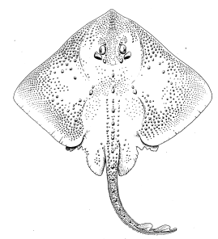
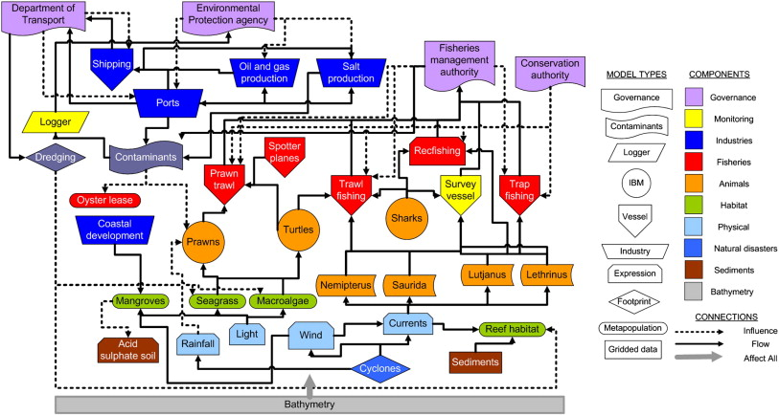
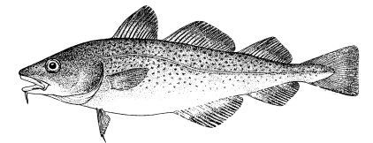
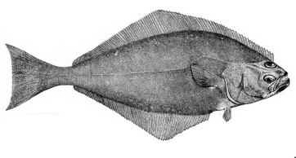
Gradient of possible modeling tools
Stock/Single Species
Multi-species
Aggregate Biomass
Ecosystem
Gadids
Pelagics
Flatfish
Single species models, forget ecosystem issues
food web models
Multi-species assessments
Extended single species models with predation mortality, habitat or climate effects
Whole system models
Aggregate Biomass Models
Multiple single species assessments in “harmony”

Slide 5
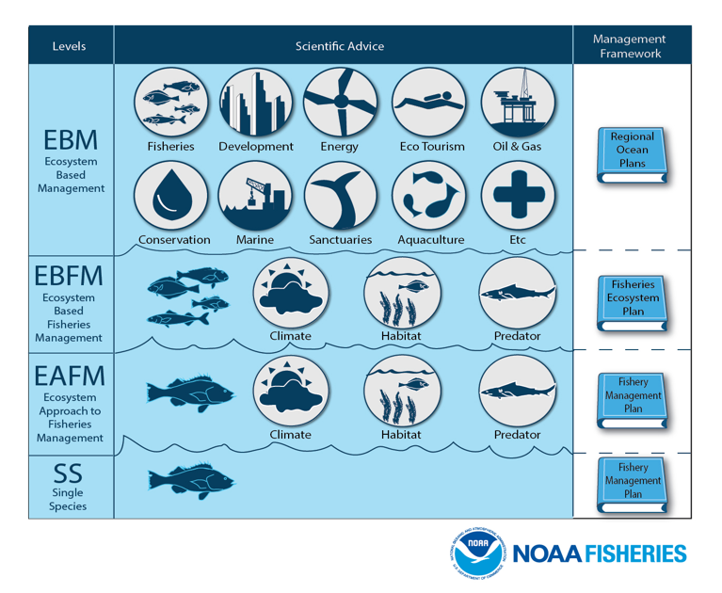

Slide 6
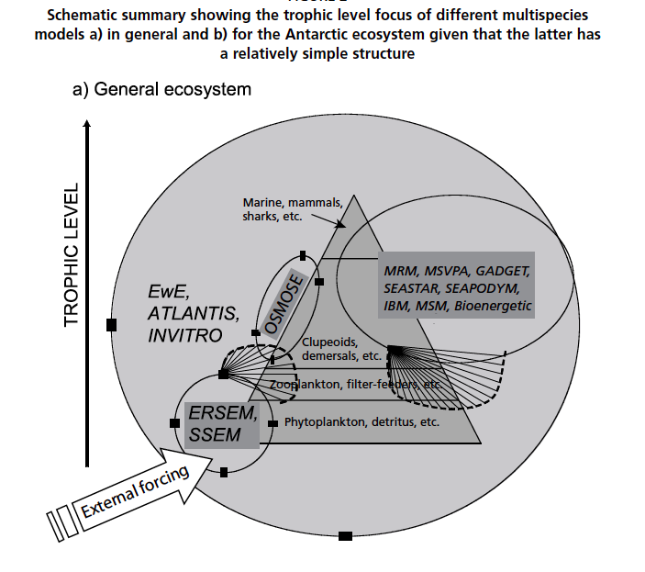
Whole of system models: focus is at system level, domains span multiple spatial, ecological, societal scales
Plagányi 2007

Slide 7
“Sunlight to Dinner plate” End-to-end model types (Fulton 2010)
Qualitative (and conceptual) models
e.g. Loop analysis
Aggregate system (or network based) models
e.g. Ecopath with Ecosim (EwE)
Biogeochemically based models
ERSEM, NEMURO, Atlantis
Coupled and hybrid models
SEAPODYM, APECOSM
Agent-based models (OSMOSE, InVitro)

Slide 8
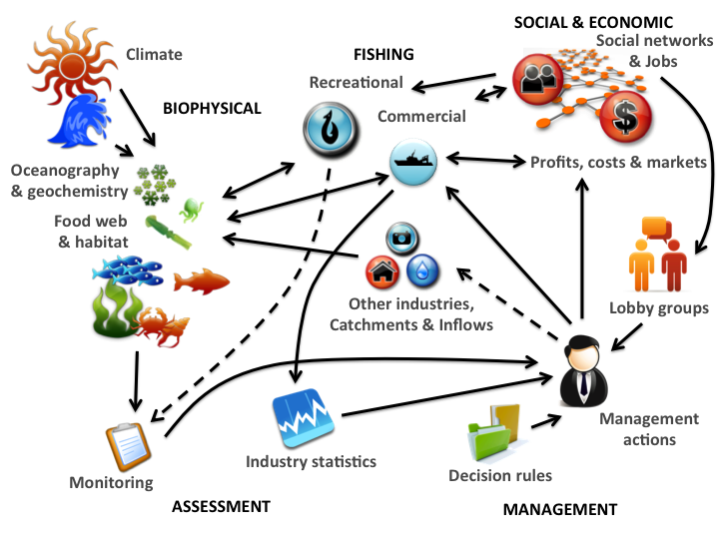
Coupled social-ecological systems

Slide 9
Whole of system models
Intended Purpose:
Evaluate management strategies in context of all potential uses and drivers of an ecosystem.
Try to look more holistically at system dynamics, yet retain necessary detail.
Models can quickly become unwieldy, output difficult to summarize and communicate.
Particularly in the model development stage, flexibility is important.
Coupled/hybrid modeling approaches have benefits of being able to stitch together existing tools, perhaps swapping model types.

Slide 10
Best practices in model development (FAO 2007, Fulton 2010)
Only include components needed for capturing critical dynamics.
Important to explicitly include feedbacks.
Address uncertainty: parameterization, model structure, associated requirements to try multiple management options.
Across all the dimensions of model construction do not default to the finest scales, often inappropriate and unnecessary.
Spatial and temporal resolution
Taxonomic resolution
Process resolution and external forcing
Anthropogenic components
Multiple model forms should be considered. There is no one “right” model.

Slide 11
Management Strategy Evaluation
DESIGN &
ANALYSIS
SIMULATION CYCLE
Simulation method for testing robustness of management methods to system drivers & pressures.
BIOPHYSICAL
DEFINE
OBJECTIVES
HUMAN USE
(INDUSTRY)
MONITORING
& REPORTING
PERFORMANCE
MEASURES
IMPLEMENTATION
(ECONOMIC, SOCIAL & PSYCHOLOGICAL INFLUENCES)
JUDGING OUTCOMES
Evaluation Table
ASSESSMENT
Management strategy
MANAGEMENT
& DECISION MAKING
Objectives
Notes:
.

Slide 12
Management Strategy Evaluation
Geophysical Drivers
Marine & Coastal Industries (& Impacts)
Social and Economic
Ecological Processes
Assessment
Evaluation Table
Management
Management strategy
Objectives
Notes:
Approach used was the MSE approach where you look at the entire system and model each part of the adaptive management process. This then produces things like the decision support table which shows the relative performance of the system against objectives under alternative management methods. This approach was used in two ways to help reach sustainable outcomes for the SESSF. First a rapid turnaround qualitative version was done using domain experts. Then a quantitative version was done using Atlantis

Slide 13
Contents - Whole Of System Model
Geophysical Drivers
Climate
Oceanography
Bathymetry
Sediment Process
Marine & Coastal Industries (& Impacts)
Recreational
Residential
Urban
Fisheries
Tourism
Oil and gas
Ports and shipping
Catchment
Agriculture
Social and Economic
Social networks
Attitudes
Markets
Costs
Investment
Revenue
Broader economy
Behaviour & decisions
Ecological Processes
Nutrient cycles
Oxygen and pH
Habitats
Production
Food webs (Biodiversity)
Feeding and growth
Waste
Mortality
Movement
Reproduction
Evolution
Assessment
Monitoring
Estimation
Management
Control Rules
Regulation (input & output & spatial)
Notes:
Atlantis covers many of the interlinked processes and components of marine ecosystems, though it is primarily focused on fisheries on the human side of things.
Note that there is no fixed form, there is a lot of alternative components that can be plug and play

Slide 14
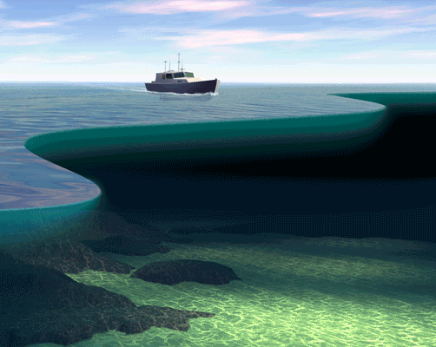
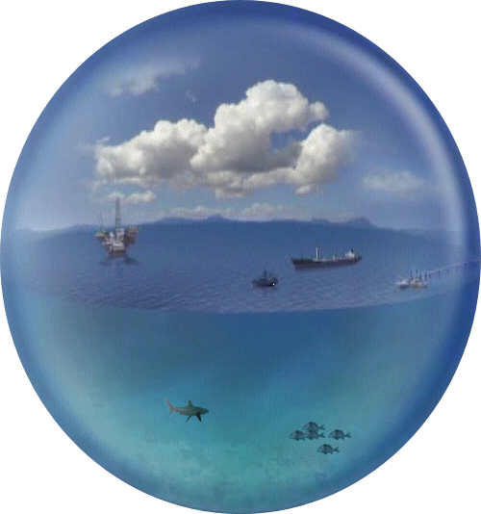
Play out alternative futures
Define objectives
MODEL
SPACE
$

Slide 15
Behavioural Uncertainty
Focus
Resource State
Environmental, ecological and
demograhic variation
Misreporting
Learning & alignment
dynamics
Reporting
Sampling and
estimation error
Resource
Blamed
Monitoring
Fishing operations
and impacts
Assess system
Unexpected
behaviour
activity
Fishing
Assessment
Assessment
model error
Make decisions
Circumvent intent
decisions
Implement
Management
Lack of regulatory
control
Decision
uncertainty
Political pressure
Human Components
< 0.06% of literature

Slide 16
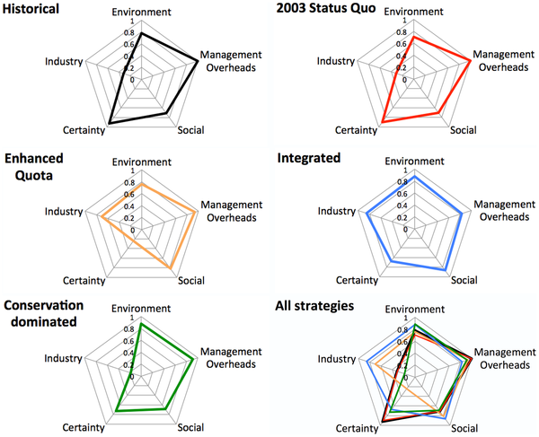
End to end models allow for evaluation of tradeoffs across broader suite of objectives at system level.
Fulton EA, Smith ADM, Smith DC, Johnson P (2014) An Integrated Approach Is Needed for Ecosystem Based Fisheries Management: Insights from Ecosystem-Level Management Strategy Evaluation. PLoS ONE 9(1): e84242. doi:10.1371/journal.pone.0084242
http://127.0.0.1:8081/plosone/article?id=info:doi/10.1371/journal.pone.0084242

Slide 17
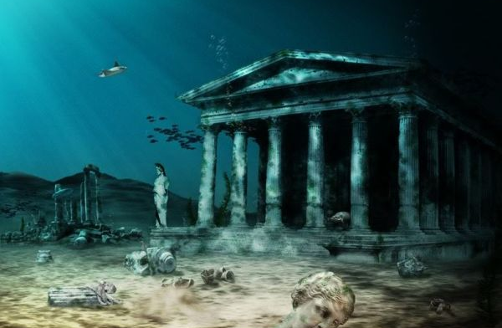
Atlantis – a whole of system model

Slide 18
Purpose
What-if sandbox
model complexity
ecological understanding
whole of system understanding
fisheries
management systems
social and economic behavior
cumulative (climate) impacts
‘Flight simulator for managers’
Notes:
Its NOT a tactical tool it’s a what-if sandbox to play in and get a feeling of what things systems may do if you bring in different management methods

Slide 19
Atlantis Contents
Geophysical Drivers
Marine & Coastal Industries (& Impacts)
Social and Economic
Ecological Processes
Assessment
Evaluation Table
Management
Management strategy
Objectives
Notes:
Approach used was the MSE approach where you look at the entire system and model each part of the adaptive management process. This then produces things like the decision support table which shows the relative performance of the system against objectives under alternative management methods. This approach was used in two ways to help reach sustainable outcomes for the SESSF. First a rapid turnaround qualitative version was done using domain experts. Then a quantitative version was done using Atlantis

Slide 20
Atlantis Contents
Geophysical Drivers
Climate
Oceanography
Bathymetry
Sediment Process
Marine & Coastal Industries (& Impacts)
Recreational
Residential
Urban
Fisheries & Aquaculture
Tourism
Oil and gas
Ports and shipping
Catchment
Agriculture
Energy
Social and Economic
Social networks
Attitudes
Markets
Costs
Investment
Revenue
Broader economy
Behaviour & decisions
Human demography
Ecological Processes
Nutrient cycles
Oxygen and pH
Habitats
Production
Food webs (Biodiversity)
Feeding and growth
Waste
Mortality
Movement
Reproduction
Evolution
Assessment
Monitoring
Estimation
Management
Control Rules
Regulation (input & output & spatial)
Notes:
Atlantis covers many of the interlinked processes and components of marine ecosystems, though it is primarily focused on fisheries on the human side of things.
Note that there is no fixed form, there is a lot of alternative components that can be plug and play

Slide 21

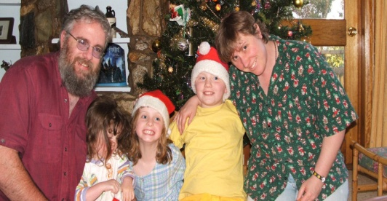
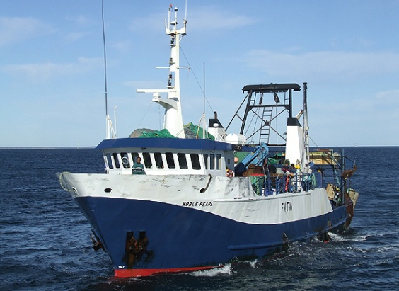
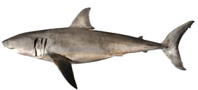
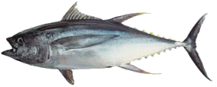
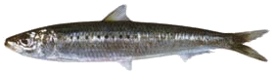
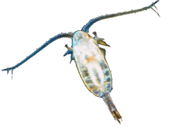
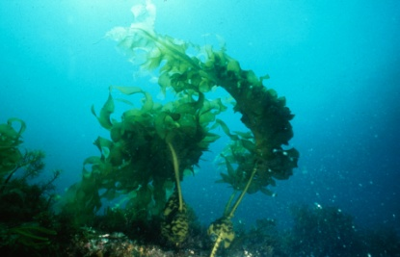
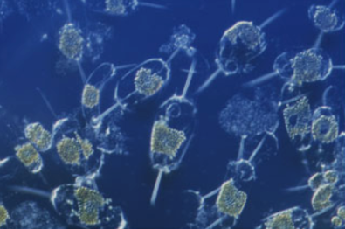
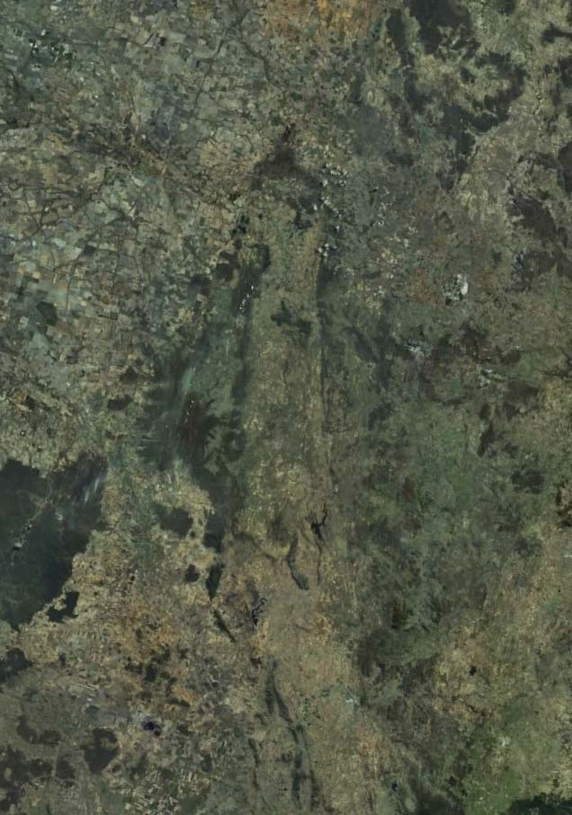
Atlantis - Putting It Together
MANAGEMENT
SOCIOECONOMIC
INDUSTRIES
PREDATORS
FOOD WEB
PLANKTON
HABITAT
ENVIRONMENT
Notes:
So we’ve tackled this by building virtual worlds that start with the land

Slide 22
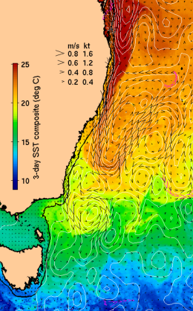
Atlantis - Putting It Together
MANAGEMENT
SOCIOECONOMIC
INDUSTRIES
PREDATORS
FOOD WEB
PLANKTON
HABITAT
ENVIRONMENT
Notes:
And then bathymetry and currents and water properties

Slide 23

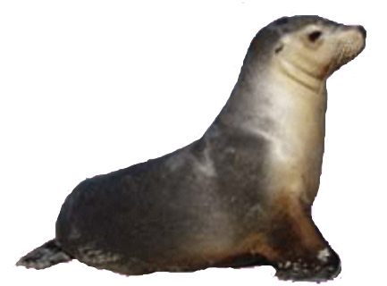
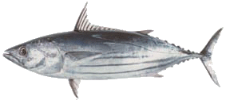
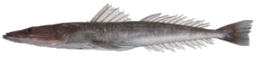
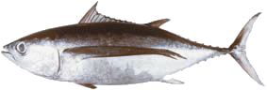
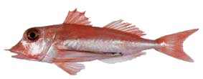
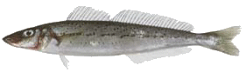
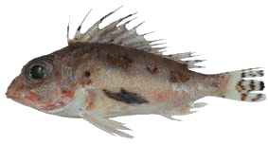
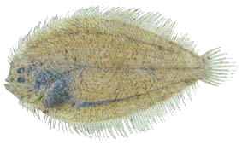
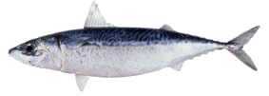
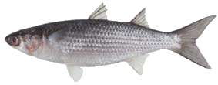
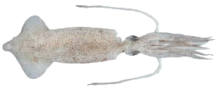
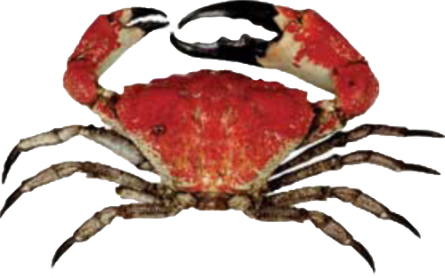
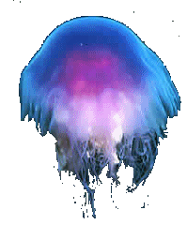
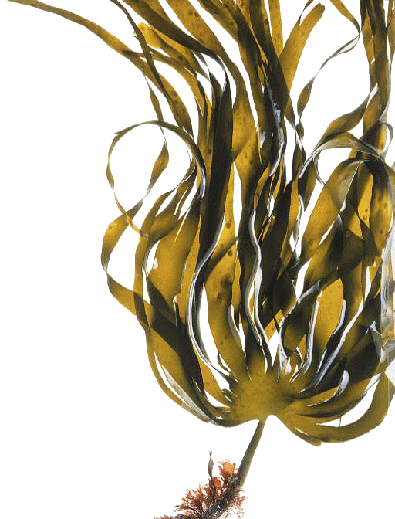

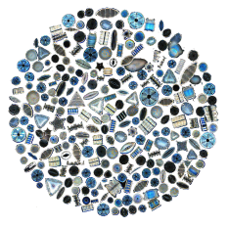
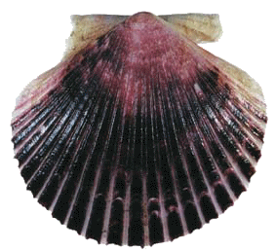
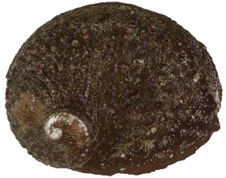
Atlantis - Putting It Together
MANAGEMENT
SOCIOECONOMIC
INDUSTRIES
PREDATORS
FOOD WEB
PLANKTON
HABITAT
ENVIRONMENT
Notes:
Then add all the ecological components – the entire foodweb from nutrients and microfauna right through to the target fish groups, habitat, top predators and charismatic megafauna.
We are also tackling the new science challenges of how you represent evolution, biodiversity.

Slide 24

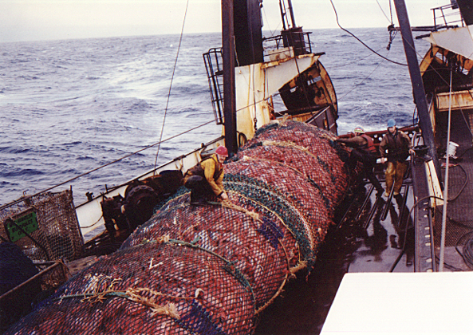


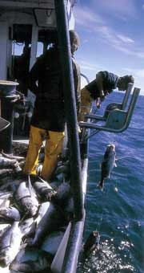
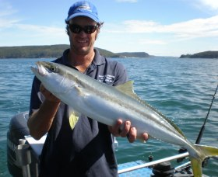
Atlantis - Putting It Together
MANAGEMENT
SOCIOECONOMIC
INDUSTRIES
PREDATORS
FOOD WEB
PLANKTON
HABITAT
ENVIRONMENT
Notes:
But it is also important to include the human side, the impacts many different activities in the coastal strip and the fisheries that are the focus of the analysis

Slide 25
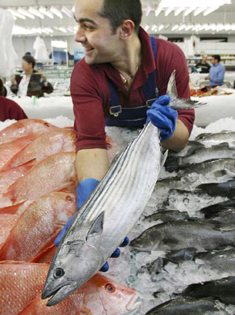
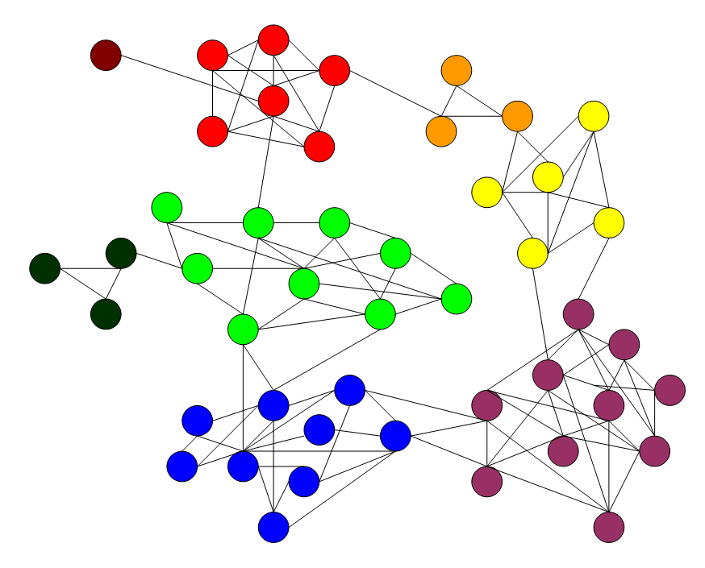
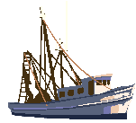
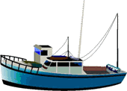
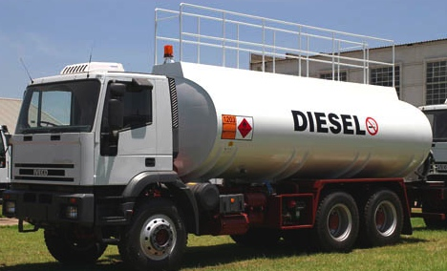
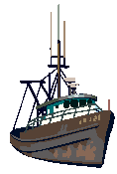
Atlantis - Putting It Together
MANAGEMENT
SOCIOECONOMIC
INDUSTRIES
PREDATORS
FOOD WEB
PLANKTON
HABITAT
ENVIRONMENT
Notes:
It is also important to represent the social and economic pressures that dictate the decisions made by operators in those systems - and the dynamics of human behaviour (because economics just doesn’t cut it)

Slide 26

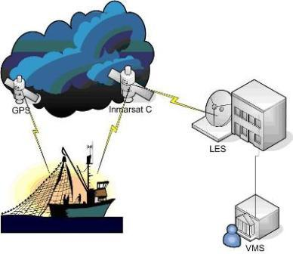
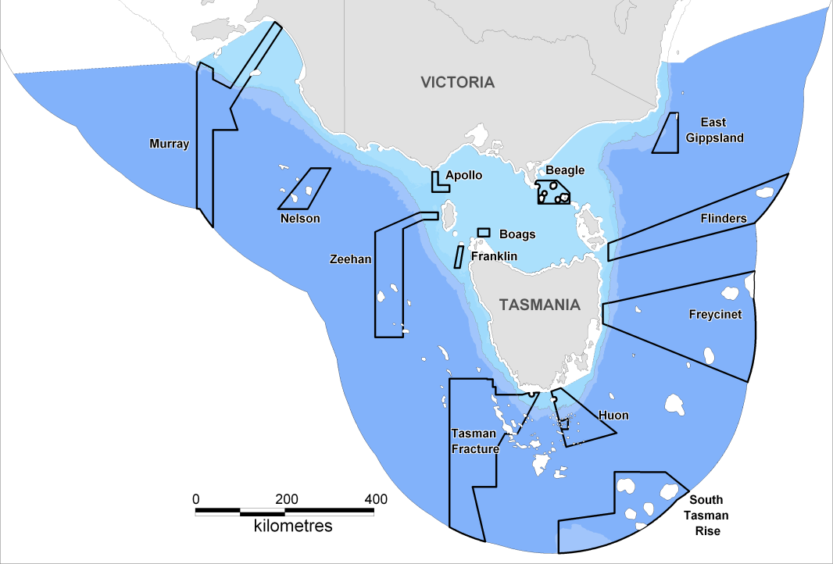



Atlantis - Putting It Together
MANAGEMENT
SOCIOECONOMIC
INDUSTRIES
PREDATORS
FOOD WEB
PLANKTON
HABITAT
ENVIRONMENT
Notes:
Lastly we close the representation of the adaptive management cycle by including the management methods and decision making process.
This does cover a lot – but that’s because important processes for marine ecosystems cover 14 orders of magnitude in space and time from microbial scales to ocean basins. More importantly even management deals directly with scales from 10s metres to 1000s kms.

Slide 27
Usefulness of Atlantis
Strategic insights
synthesize information, identify key processes
simulate possible ecosystem responses (e.g. climate change)
set management reference points
NOT for tactical management
How does the system behave given:
Hypotheses for system structure & function
Impacts of large scale change (pressures)
What management levers work?
How do levels of human activities tradeoff against management objectives?
What monitoring/assessment methods are reliable?
Are there robust management rules?

Slide 28


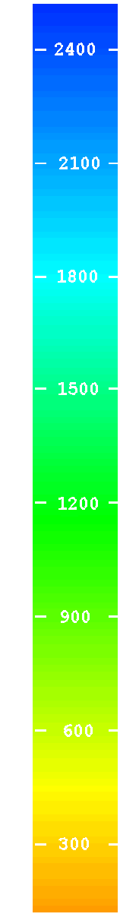

Physical
0
50
150
250
750+
Pelagic
flows
upwelling (to surface or at depth)
Epibenthic
Sediment
Notes:
The geography of the model uses boxes based on the same logic as bioregions (so it use bathymetry, water properties, seasonal currents and biological distributions to define the boxes). Small boxes where properties change quickly, large where properties change more slowly over large areas. It is an efficient way of handling computational load (computer time) and data so put the focus where the biophysical action happens.
Layers down through the watercolumn are defined in a similar way.
There is current flow between boxes and across layers in the model.

Slide 29

Geophysical
Bottom types (rough, flat, soft)
Canyons
Notes:
The geological features in each box are defined (so seabed type, coverage of rocky reefs etc) and canyons (because lots of ecological action happens there)

Slide 30

Hydrodynamics
Currents
horizontal
vertical
Temperature
Salinity
Eddies
Notes:
We get the currents and water flow from ocean models like BLUELINK so we have as good a time series as possible.

Slide 31




Ecological models
Multiple options for major processes (e.g. feeding, movement, reproduction) Model currency is Nitrogen – converted to biomass
Notes:
Biological components
Differential equations
Major processes covered (feeding, dying, reproduction, movement)
Major groups (defined by user at start but generally cover size and feeding group structured representation of entire foodweb, pelagic and demersal from bacteria and phytoplankton up to top predators, plus species of particular commerical or conservation concern)
Most invertebrates = aggregate pools, but vertebrates (and some inverts) have age structure so can catch ontogenetic change in behaviour and pressures

Slide 32



Diets
A function of availability, spatial overlap, and preference
Ontogenetic shifts
Flexible in space and time
Notes:
The way we model diest means it can change through time and space flexibly (like diets do in reality). The match between the bars show that while we don’t get it exactly right we get it fairly close which is great for the model purposes.

Slide 33
1910
pelagic sharks
toothed whales
demersal fish
pelagic fish
demersal sharks
birds
baleen whales
squid
small pelagics
zoobenthos
filter feeders
zooplankton
jellies
infauna
detritus
macrophytes
phytoplankton
Notes:
Can use it to look at past system changes too
Rectangles = biomass pools and trapezoids represent idea of size structure in vertebrate pools (small age classes on left of the trapezoid and large age groups on right)
This is the unfished foodweb for the southern eastern shelf off Victoria (actually a simplified representation of the model there, but captures the major features to get the idea across)
- Its too complicated with everything shown, so I’ve only shown the shelf parts from the southern section of the model and I’ve only shown the major flows
- bit over “rock” = benthic (rest = pelagic)
- rectangular boxes = invertebrates and detritus
- polygons are vertebrates showing relative proportion of group made up of juvenile and adults
- green = photosynthetic
- purple = bacteria
- grey = detritus
- yellow = zooplankton
- aqua = gelatinous zooplankton
- orange = benthos (light = infauna, dark = epifauna)
- black = cephalopds
- light blue = planktivores
- medium blue = piscivores
- deep blue = demersal fish
- red = sharks and rays
- pink = birds and mammals

Slide 34
1910
Notes:
Lets focus on the fish. It starts like this (and remember size of the boxes and arrows is roughly logarithmic based)

Slide 35
2000
Notes:
Flicking between this state and the previous one you see that the pelagics and cephalopods and jellies have gotten bigger whereas lost large bodied animals like sharks (and also the biggest age classes so gone from trapezoids to triangles)

Slide 36



Sectors of human activities
river or major inputs ports currents
Non-fishing (nutrient/pollutants, global climate, habitat degradation)
Fishing (multiple fleets, gears, management rules)
Notes:
On the human side of things we cover non-fishing things like pollution and coastal development and ports etc but in a painted forced scenario way. The fisheries are covered in fine detail however (including targeting, vessel size, home ports, gear etc) – means you can get different behaviour for different components of the fisheries.

Slide 37

Socioeconomics
Indicators
Effort allocation (by subfleet)
Economic drivers
Social drivers
Behavioural uncertainty (usually ignored)
Notes:
We also cover the economic and social aspects of effort allocation, this means we cover uncertainty due to human behaviour (often forgotten and assumed people just react as rational automatons)

Slide 38

Fishing decisions can occur at multiple time scales
Notes:
Use a nested cycle of decision making
Annual plan
Monthly refinements
Trip by trip final decisions on what is to be done

Slide 39
Lots of options for how fishing decisions can be modeled
Tiered planning and effort allocation
Quota trading
Markets
Multiple cost sources (fixed, variable, crew, gear, fuel)
Investment and disinvestment
Social and economic indicators
Costs of management (across compliance, research, infrastructure, monitoring)
recovered costs
per sector
Notes:
So it covers the many drivers of effort allocation decisions

Slide 40
Reporting / Monitoring
Industry dependent reporting
observers (can modify behaviour)
Fisheries independent data possible
show costs and benefits of monitoring
With error (multiple scales and patchiness)
Designed to generate monitoring data that reflects that which would be available
(also see ‘atlantisom’ R package)
Notes:
Observation model includes fisheries records + option for independent surveys
Replicates data patchiness/error/design problems
Assessment models = range of ones typically used from simple trend analysis to highly sophisticated (complicated) assessment methods
- Also includes the calculation of ecological indicators (if you want to think about what real Dept of environment driven EBFM might entail)

Slide 41

Management Levers
Gear (size, selectivity, access to habitat types)
Swept area (or soak time)
Spatial zoning (per sector through to closures, rolling)
Seasons
Discarding rules (bycatch reduction devices, size, per species, per area, limits)
Bag limits
Quotas (overall, stock-based, regional, basket, companion, bi-monthly)
Trip limits
Effort limits (days-at-sea)
Compliance

Slide 42

Decision Rules
Lobbying
Political process (with delays)
Trigger points
Harvest strategies
Includes assessments
Harvest control rules
Notes:
The management decision making process can reflect the more lobby driven or politically driven version of the world or it can simply apply harvest control rules or other reference point based management.

Slide 43
Model development – stages
Usually, incremental calibration at each stage.
Each provides own kind of information even if don’t progress further.
Ecology Alone
Forcing History
Match History
Predictions

Slide 44
Calibration and fits to history
Training and test set concept, are general trends ok?
Individual humans = HARD to predict
aggregate behaviour predictable
Phase I: unfished scenarios
Phase 2: sensitivity to fixed fishing mortalities, estimates of MSY and FMSY
Phase 3: comparison to historical trends
Goal is for calibrated model productivity to be biologically plausible, as evidenced by tests of no fishing, simple forced F, and historical fishing.
1000s of model parameters. Calibration of recruitment and consumption parameters primarily.
also interaction coefficients between predator and prey, and additional mortality terms.
Notes:
Both for the ecology and the human sides you train it up on data first (dots here) and then use that parameter set to predict gross system features (so triangles here) as your measure of how trustworthy the model “skill” is.

Slide 45
Handling Uncertainty
Atlantis is a (largely) deterministic model
1000s of parameters
Make do with:
loop analysis
multiple specifications (& multiple models)
functionality filters (look at sensitive subsets)
perturbation analysis
bounded parameterisations
but see recent work on the Norwegian/Barents Sea and Gulf of California models…

Slide 46
Handling Uncertainty
Specification
Strategy
Scenario
Notes:
While this would upset prediction scientists, its best we can do and is tolerable given relative what-if world we’re interested in

Slide 47
Running Atlantis
Atlantis is run from the terminal (command prompt) using a batch file (windows) / shell script.
atlantisNew -i init.nc -o output.nc -r at_run.prm -f at_force.prm -p at_physics.prm -b at_biol.prm -h at_harvest.prm -a at_assess.prm -e at_economics.prm -s FunctionalGroups.csv -q Fisheries.csv -d output_directory
Also need
.exe installed
forcing hydro, temp etc.
input time series
bgm file
fstatistic_blank.nc
diagnostic_blank,nc
other files are auto-generated
Notes:
C:\Documents and Settings\kaplanis\My Documents\Atlantis\EMOCC_AtlantisWorkingCopy\run_emocc\RealNewellAug2009Hi0Free

Slide 48
Code overview – main steps
Main
Setup (Initialisation)
Record state
Time check
Assessment
Fleet dynamics
Biology
Physics

Slide 49
Code overview – main steps
Main
Setup (Initialisation)
Read in run configuration
Read in run parameters
Read in geometry
Read in physical properties
Read in initial conditions
Create arrays
Create output files
Read in parameters
Set up parameter arrays
Initialise fisheries and biological groups

Slide 50
Code overview – main steps
Main
Time of Year
Output physical
characteristics
Time of Day
Output biological
variables
Record state
Time check
Activity states
Output fisheries
statistics
Parameter
corrections
Data collection
Annual management
Data handling
Fleet dynamics
and socioeconomics
Assessment
CPUE updating
Assessment
Economic response
Calculate indicators
Effort allocation
Biophysics
(Light and Oxygen)
Biology
Exchanges
Physics
Movement
Sediment processes
Biological processes
End
Transport
Reproduction

Slide 51
Running Atlantis
Atlantis is run from the terminal (command prompt) using a batch file (windows) / shell script.
atlantisNew -i init.nc -o output.nc -r at_run.prm -f at_force.prm -p at_physics.prm -b at_biol.prm -h at_harvest.prm -a at_assess.prm -e at_economics.prm -s FunctionalGroups.csv -q Fisheries.csv -d output_directory
Also need
.exe installed
forcing hydro, temp etc.
input time series
bgm file
fstatistic_blank.nc
diagnostic_blank,nc
other files are auto-generated
Notes:
C:\Documents and Settings\kaplanis\My Documents\Atlantis\EMOCC_AtlantisWorkingCopy\run_emocc\RealNewellAug2009Hi0Free

Slide 52
Define run period
Build a present-day model, tune it, run it
Forward simulations
2009
Data model
Create past model, fit to data, create present model
Historic data fitting
Forward simulations
1950
2009
Data model
Derived model
Historic data fitting
1950
2009
Best of both worlds
(assumes stationarity)
Data model
Derived model
Transfer dynamic parameters (but not initialization state)
Forward simulations
2009
Data model

Slide 53
Spin-up period
Historic fishing
No fishing
Forward simulations
Any
Virgin
2009
Data model
Derived model
Derived model
‘Spin up’ period
Can create new model
(or not)

Slide 54

Exploring the input files
Open at_run_neus_v15_DE.prm
Atlantis stops when:
parameter is wrong type or missing (error message on what went wrong)
You delete ‘delete_to_halt_run’
flux error (symptom that rates wrong, check params)
program crash (rare, but not impossible....)

Slide 55
Output
Atlantis outputs a bunch of text and netcdf files, e.g.
physics = out.nc
ecological = out.nc, outTOT.nc, outPROD.nc, biol.txt, YOY.txt
assessment = indicator files (long list grouped by indicator type)
fisheries and management = outCATCH.nc, outTOTCATCH.nc, catch.txt, effort.txt, catch_per_fishery.txt
socioeconomics = econ.txt

Slide 56
First output to consider
Output File | Contents | Viewing/ Processing
Out.nc | Spatial Biomass, Numbers Rn, Sn by functional group and age class | OLIVE/DIVE, R
OutBiomIndx.txt | Yearly Biomass (mt) by Functional Group | Text Editor, Excel, R
OutCatch.txt (OutCatchPerFishery.txt) | Yearly Catch (mt) by Functional Group (by fishery) | Text Editor, Excel, R
Log.txt | Code and calibration messages | Text Editor, R

Slide 57

Log.txt - errors and in-run messages many controls over verbosity for debugging
Notes:
57

Slide 58


Viewing .nc files OLIVE & DIVE Less frequently used now, new applications in R
Interprets .nc files
Select group
Select a cell
3 dimensions
+4th = time
XY
Z
TIME
Notes:
58

Slide 59


Plotting time series output
e.g. via R scripts
Notes:
59

Slide 60
Other output R tools
r4atlantis organization
vadt - visualizing atlantis diagnostic tool
(www.github.com/mareframe/vat)
atlantistools – R package for calibrating, visualizing, diagnosing Atlantis models
(https://github.com/alketh/atlantistools)
ratlantis - Building Atlantis models
(https://github.com/jsgosnell/ratlantis)
Code for interacting with Atlantis Northeast US model - Erik Olsen
(https://github.com/erikjsolsen/AtlantisNEUS_R)
http://dx.doi.org/10.1371/journal.pone.0146467

Slide 61



Video game style output using Virtual Ecosystem Viewer (VES-V) videos combining animation and narratives
Web link here if now live?
Notes:
Animations allow viewing of model (or data) output in ‘real-life’. Users can scroll through scenarios to see temporal changes in community biomass and composition, and also across different management scenarios. Versions of the California Current. NE US, and GoMEx.

Slide 62

Summarizing Output

Slide 63

How to use Atlantis?
Collaboratively, data requirements require lots of expertise.
Atlantis (and most end-to-end models) is most effectively used strategically as a ‘what-if’ tool (e.g. MSE approach).
Community actively developing tools and helper functions.
Best practices at each stage have been identified, including how to review these models (new in ICES JMS, Marshall & Kaplan)
There is no one “right” model to use, multi-model inference is preferable, maintain flexible approach to implementation.
Whole of system models allow us to look at tradeoffs across entire system.

Slide 64

mgt. scenario
scenarios

Slide 65
Suggested reading
Fulton, E.A., 2010. Approaches to end-to-end ecosystem models. Journal of Marine Systems, 81(1), pp.171-183.
Fulton, E.A., Link, J.S., Kaplan, I.C., Savina‐Rolland, M., Johnson, P., Ainsworth, C., Horne, P., Gorton, R., Gamble, R.J., Smith, A.D. and Smith, D.C., 2011. Lessons in modelling and management of marine ecosystems: the Atlantis experience. Fish and Fisheries, 12(2), pp.171-188.
Fulton, E.A., Smith, A.D., Smith, D.C. and Johnson, P., 2014. An integrated approach is needed for ecosystem based fisheries management: insights from ecosystem-level management strategy evaluation. PloS one, 9(1), p.e84242.
Griffith, G.P., Fulton, E.A., Gorton, R. and Richardson, A.J., 2012. Predicting Interactions among Fishing, Ocean Warming, and Ocean Acidification in a Marine System with Whole‐Ecosystem Models. Conservation Biology, 26(6), pp.1145-1152.
Harfoot, M.B., Newbold, T., Tittensor, D.P., Emmott, S., Hutton, J., Lyutsarev, V., Smith, M.J., Scharlemann, J.P. and Purves, D.W., 2014. Emergent global patterns of ecosystem structure and function from a mechanistic general ecosystem model. PLoS Biol, 12(4), p.e1001841.
Kaplan, I.C., Horne, P.J. and Levin, P.S., 2012. Screening California Current fishery management scenarios using the Atlantis end-to-end ecosystem model. Progress in Oceanography, 102, pp.5-18.
Kaplan, I.C., Gray, I.A. and Levin, P.S., 2013. Cumulative impacts of fisheries in the California Current. Fish and Fisheries, 14(4), pp.515-527.
Link, J.S., Fulton, E.A. and Gamble, R.J., 2010. The northeast US application of ATLANTIS: a full system model exploring marine ecosystem dynamics in a living marine resource management context. Progress in Oceanography, 87(1), pp.214-234.
Punt, A.E., Butterworth, D.S., Moor, C.L., De Oliveira, J.A. and Haddon, M., 2014. Management strategy evaluation: best practices. Fish and Fisheries
Smith, M.D., Fulton, E.A. and Day, R.W., 2014. An investigation into fisheries interaction effects using Atlantis. ICES Journal of Marine Science: Journal du Conseil, p.fsu114.
Steele, J.H., Aydin, K., Gifford, D.J. and Hofmann, E.E., 2013. Construction kits or virtual worlds; Management applications of E2E models. Journal of Marine Systems, 109, pp.103-108.
Travers, M., Shin, Y.J., Jennings, S. and Cury, P., 2007. Towards end-to-end models for investigating the effects of climate and fishing in marine ecosystems. Progress in oceanography, 75(4), pp.751-770.

Slide 66


Questions?
Atlantis Ecosystem Model Summit
December 7th-11th, 2015
Honolulu, Hawaii

Slide 67
Next time on Models for Marine EBM….
(April 22)
Qualitative Modeling

Slide 68
Today’s Outline
Whole of System Modeling
Ecosystem MSE
Atlantis
LAB / ASSIGNMENT
Scenario evaluation/analysis using Northeast US Atlantis model
Produce Figures, interpretation for a joint paper/report on a set of scenarios.

Slide 69













Atlantis Northeast US
Pelagic
45 Functional Groups
0
50
120+
300+
Epibenthic
Sediment
18 Fishing fleets
Link JS, Gamble RJ, Fulton EA. 2011. NEUS – Atlantis: Construction, Calibration, and Application of an Ecosystem Model with Ecological Interactions, Physiographic Conditions, and Fleet Behavior. NOAA Tech Memo NMFS NE-218 247 p. Available at http://www.nefsc.noaa.gov/nefsc/publications/.
Notes:
Quantify tradeoffs in management performance against a broader range of objectives.
Examine a more diverse suite of indicators.
Linkages to additional models.
Performance of fisheries policy options under scenarios of global change.
How to best make use of available data.

Slide 70

here

Slide 71

Northeast US: Indicators sensitive to effects of acidification, magnitude depends on scenario
Effects of acidification transfer to species not directly vulnerable.
Can see large negative effects on fisheries yield.
Dependent on detail of modeling acidification effects. Future versions of our Atlantis model will model functional responses to pH and ocean chemistry.
Results from the Northeast US compare with findings elsewhere.
Fay et al. In Review. MEPS

Slide 72


Atlantis: Ocean warming
Scenarios with fixed increases in mean temperature
Changes in temperature affect functional group attributes: feeding rates, metabolic rates, mortality, etc.
Temperature increase alone causes notable increases in some groups, slight decline in others.
J.A. Nye et al. 2013. Ecological Modelling 264: 157– 168

Slide 73

Fishing with threshold-based limit on exploitation: ecological benefits with little economic cost

Slide 74

Aggregate indicators can mask variable outcomes

Slide 75
Common Scenarios - The grand idea
How will human pressures affect our marine ecosystems in the future?
Climate change
Fishing
Industrial use (oil, renewables)
Compare a range of future scenarios for all Atlantis models worldwide to cover
N – S axis
Climate gradients (Arctic – Tropic)

Slide 76
Common Scenarios - Products
Shared code for intercomparison
GitHub
Paper(s)
Compare base-case across models
Responses to stressors
Climate change
Fisheries
Industrial activities
Scenario specifications
https://docs.google.com/document/d/1KW9xr7EyR5EVP2alhnkrh-zM6FhfNscDQRAvQaSYLZ4/edit#heading=h.dzq210m2m9w0

Slide 77
Tasks
Common scenario analysis for NEUS model
Figures comparing scenarios within NEUS
Additional detail
Indicator plots
Compare among scenarios
Choose which indicators
Visualizing NEUS using ‘atlantistools’ / ‘vat’
Helpful for diagnostics of new NEUS model

